Slide 1

Credit Card
Weekly Status Report
Aniket Kumbhar

Slide 2
Agenda
Project objective
Data from SQL
Data processing & DAX
Dashboard & insights
Export & share project

Slide 3



Project Objective
To develop a comprehensive credit card weekly dashboard that provides real-time insights into key performance metrics and trends, enabling stakeholders to monitor and analyze credit card operations effectively.

Slide 4
Import data from SQL database
Prepare csv file
Create tables in SQL
Import csv file into SQL
Note : Find all SQL queries & project data - nirman-saini07/Credit_Card_Financial_Dashboard: Power BI Dashboard (github.com)

Slide 5
DAX Queries
AgeGroup = SWITCH(
TRUE(),
'public cust_detail'[customer_age] < 30, "20-30", 'public cust_detail'[customer_age] >= 30 && 'public cust_detail'[customer_age] < 40, "30-40", 'public cust_detail'[customer_age] >= 40 && 'public cust_detail'[customer_age] < 50, "40-50", 'public cust_detail'[customer_age] >= 50 && 'public cust_detail'[customer_age] < 60, "50-60", 'public cust_detail'[customer_age] >= 60, "60+",
"unknown" )
IncomeGroup = SWITCH(
TRUE(),
'public cust_detail'[income] < 35000, "Low",
'public cust_detail'[income] >= 35000 && 'public cust_detail'[income] >= 70000, "High", "unknown“
)

Slide 6
DAX Queries
week_num2 = WEEKNUM('public cc_detail'[week_start_date])
Revenue = 'public cc_detail'[annual_fees] + 'public cc_detail'[total_trans_amt] + 'public cc_detail'[interest_earned]
Current_week_Reveneue = CALCULATE(
SUM('public cc_detail'[Revenue]),
FILTER(
ALL('public cc_detail’),
'public cc_detail'[week_num2] = MAX('public cc_detail'[week_num2])))
Previous_week_Reveneue = CALCULATE(
SUM('public cc_detail'[Revenue]),
FILTER(
ALL('public cc_detail’),
'public cc_detail'[week_num2] = MAX('public cc_detail'[week_num2])-1)

Slide 7

Project Insights – Week 53 (31st Dec)
Wow change:
Revenue increased by 28.8%,
Total Transaction Amt & Count increased by xx% & xx%
Customer count increased by xx%
Overview YTD:
• Overall revenue is 57M
• Total interest is 8M
• Total transaction amount is 46M
• Male customers are contributing more in revenue 31M, female 26M
• Blue & Silver credit card are contributing to 93% of overall transactions
• TX, NY & CA is contributing to 68%
• Overall Activation rate is 57.5%
• Overall Delinquent rate is 6.06%

Slide 8
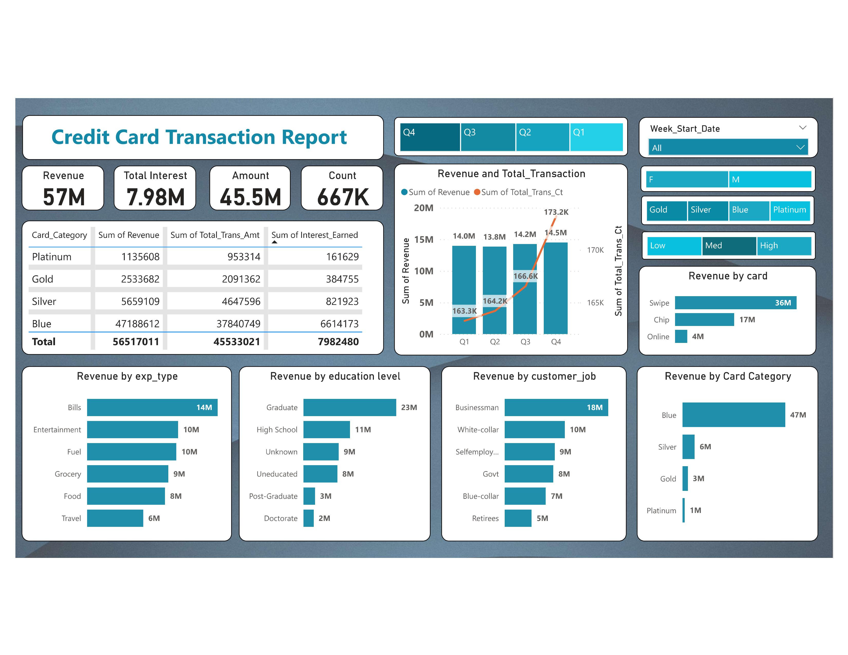

Slide 9
